Slide 1
PREDICTION OF ONLINE SHOPPERS PURCHASING INTENTION
Raghunath Babu A20511598
Aditya Shivakumar A20513527

Slide 2
ABSTRACT
Currently many businesses rely on the internet to operate, online stores have now realized the importance of personalized advertising.
Machine learning can be used for predicting the buying intentions of online consumers.
Machine Learning is capable of analyzing enormous quantities of information and identify trends and patterns that are difficult to spot via manual analysis.
The objective is to develop machine learning models to perform classification by grouping similar customers based on their purchasing behavior and predict if a customer could do a purchase.

Slide 3
DATASET
Numerical Attributes:
Administrative
Administrative_Duration
Informational
Informational_Duration
Product
Product_Duration
Bounce Rate
Exit Rate
Page Value
Special Day

Slide 4
DATASET
Categorical Attributes:
Operating System
Browser
Region
Traffic Type
Visitor Type
Weekend
Month of the Year
Revenue

Slide 5
Approach
APPROACH
This data set has a mix of numerical and categorical feature variables, the predictive variable is binary(True/False)
This gives us an opportunity to explore
Classification(modelling)
Clustering(Analysis)

Slide 6
PRE PROCESSING
The 8 categorical variables were translated into numericals
True/false→ 1/0
Months→ feb to dec as 2 to 12
Qualitative variable→ 0/1 and 2 for missing values

Slide 7
PRE PROCESSING
For a better model with more categorical and continuous variable it is necessary to check
significance of the variable
Variables are independent
Mutually exclusive
Chi Square statistical test is performed, for every variables and the target variable individually.
Chi square distribution is a probability distribution used commonly used in Statistical Inference-test of significance, variable independence
H0: no significant relation
Ha: significant relation exist
If the p value is significant enough we can reject the null hypothesis.(0.05)

Slide 8
PRE PROCESSING
P VALUE
P value is a measure of the evidence against null hypothesis
If the p value is more than the level of significance, we reject the null hypothesis and favour alternative hypothesis
In our test we discard the following variables
Operating System- 1.4E-13
Region - 0.03
Traffic Type -1.6E-67
Visitor type -4.26E-30
Weekends -0.0012
Special Day -1.3E-21
Month -2.2E-77

Slide 9
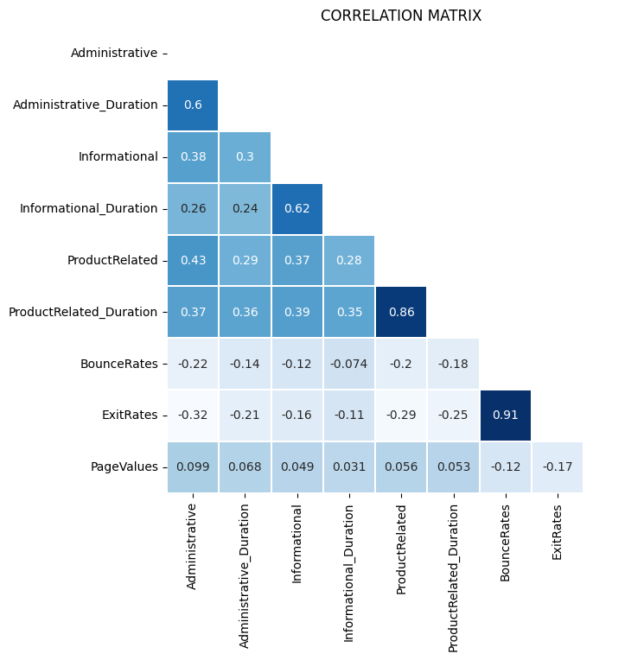
Examining the correlation between numerical variables
We have high correlation for 4 variables
BounceRates and ExitRates-0.91
ProductRelated and ProductRelated_Duration-0.86

Slide 10
Checking the multicollinearity
VIF-Variance Inflation Factor
A statistical method to detect the presence of multicollinearity
Multicollinearity- is a phenomenon when 2 or more variables highly correlated
VIF-1 indicated no multicollinearity
VIF>5/10 is considered as high multicollinearity

Slide 11
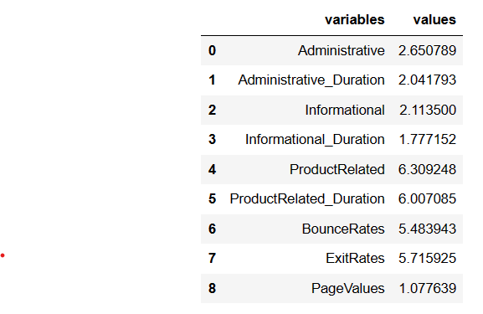
VIF FOR THE DATA SET

Slide 12
PRINCIPAL COMPONENT ANALYSIS
Principal Component Analysis (PCA) is a statistical technique used to reduce the dimensionality of a large dataset while retaining as much of its variability as possible.
STEPS FOR PCA:
Standardize the range of the continuous initial variables.
Computation of covariance matrix.
Compute the eigenvectors and eigenvalues.
Feature Vectors.
Recasting the data along the principal component axes.

Slide 13
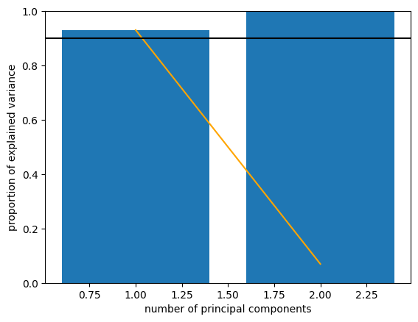
From the VIF table we found 4 variable with significant multicollinearity.
Proceeded with PCA instead of discarding.
(i) 'ProductRelated' ,'ProductRelated_Duration'
We see that with one variable we can explain more than 90% of the variance of the two original variables.
Reduced this to 1 variable
Product_Related_PCA

Slide 14
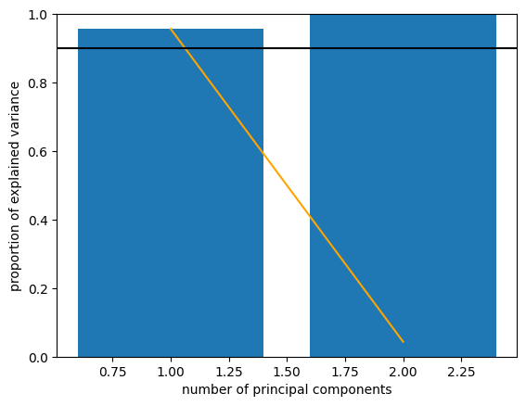
(ii) ‘BounceRates','ExitRates’
We see that with one variable we can explain more than 95% of the variance of the two original variables.
Reduced this to 1 variable
-Bounce_Exit_PCA
One hot encoding is applied on the transformed dataset

Slide 15
LOGISTIC REGRESSION
For this classification, stated with logistic regression modelling
Train, Test split- 80:20
Epochs-100
Use GridSearchCV to get the optimized hyper parameters in obtaining the most effective model
Mean Cross Validation Roc AUC score - 0.9160027575887142

Slide 16
RANDOM FOREST
In a Random Forest, multiple decision trees are trained on different subsets of the original dataset.
Each decision tree makes a prediction for the target variable.
The final prediction is determined by combining the predictions of all the individual trees.
Each tree is constructed using a random subset of the features in the dataset.
BootStrapping and Feature selection(Randomness)

Slide 17
Random forest for complete dataset
Mean Cross Validation Roc AUC score 0.9032846715328468
Max depth 12
Random forest for transformed dataset
Mean Cross Validation Roc AUC score 0.9001419302514194
Max depth 12
We can see the cross-validation result obtained for Random Forest is almost similar for"original" and transformed data.

Slide 18
NEURAL NETWORKS
Potential of Neural Networks was realized from one of the research papers.
Composed of multiple layers of interconnected nodes, or neurons.
Basic structure of a neural network consists of an input layer, one or more hidden layers, and an output layer.
Each neuron receives input from one or more other neurons and applies a nonlinear transformation to the input to produce an output.
Neural networks have ability to learn complex, nonlinear relationships between inputs and outputs.

Slide 19
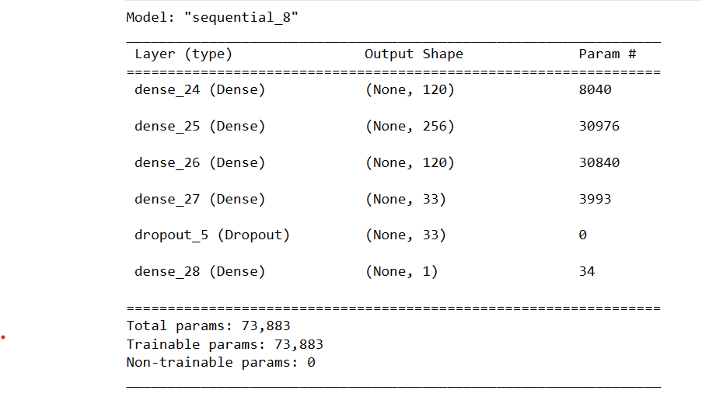
Epochs-30
Accuracy 93%
(l2 regularization, drop out layer)

Slide 20
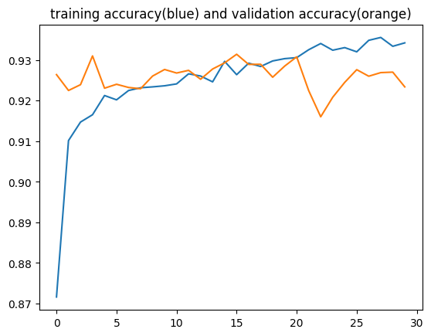
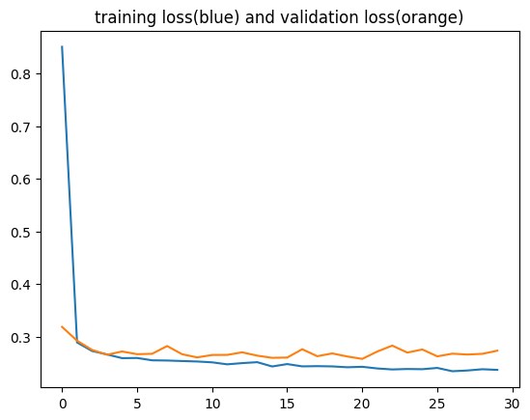

Slide 21
FUTURE WORK
Clustering
K Means
Analyse different clusters and find the dominating features over each cluster.
Basic idea is to group customers based on several feature variables which will help the company to strengthen their marketing and logistics
Analysis on the user’s characteristics in terms of time spent on the website
Administrative Duration vs Bounce Rate
Informative Duration vs Bounce Rates
Administrative Duration vs Exit Rates
From where the Users of the Website come?
Region vs Traffic Type Administrative Duration vs Region

Slide 22
Thank You

